Slide 1

BRIGHT COFFEE: 6 MONTHS SALES OVERVIEW
BY: POLITE MASEGO MOLATLHEGI
BrightLearn
31/3/2026

Slide 2


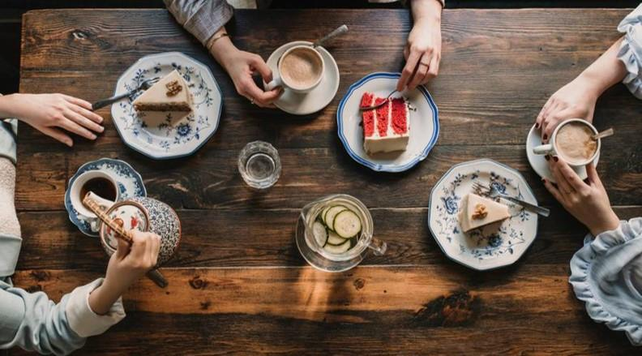
OBJECTIVE
Analyse store, product, and customer performance over 6 months Identify revenue drivers and underperforming areas Provide actionable, impact-driven recommendations
Notes:
Analyse store, product, and customer performance over 6 months Identify revenue drivers and underperforming areas Provide actionable, impact-driven recommendations

Slide 3
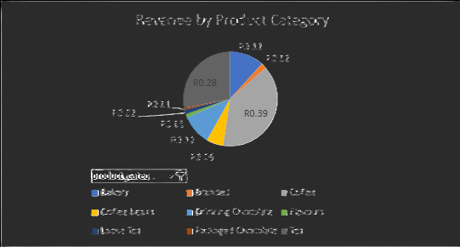
REVENUE BY PRODUCT
ANALYSIS
Coffee dominate revenue (39% of total)
Flavors and packaged chocolate contribute extraordinarily little (1%)

Slide 4

REVENUE BY STORE
ANALYSIS
Hell's Kitchen contributes 34% of total revenue
Astoria and Lower Manhattan contribute 33% each.

Slide 5
MONTHLY REVENUE BY STORE
ANALYSIS
Revenue trends fluctuate month-to-month per store
Monthly revenue growth shows a dip in February
All stores recorded higher revenue in June compared to other months

Slide 6
REVENUE VS NUMBER OF SALES
There is a positive correlation between the number of sales and revenue
Months with higher sales consistently show higher revenue

Slide 7
TOP PRODUCTS
Sustainably Grown Organic Large (R21,151.75) and Dark Chocolate Large (R21,006) drive the majority of revenue.
Mid-tier products contribute R16–19k , with Brazilian Large at R15k.

Slide 8
PRODUCT STRATEGY BY STORE
Coffee drives the highest revenue across all stores (R0.13 per store, total R0.39), while tea, bakery, branded products, and flavor (the lowest at R0.01) contribute less, highlighting key areas for strategic focus.

Slide 9
TIME OF DAY BEHAVIOR
Sales peak in the mid-morning, with demand gradually declining throughout the day and lowest activity at night.
This indicates customer purchasing is strongly concentrated in the early part of the day.

Slide 10
PEAK PERIODS
Mid-morning is the dominant revenue driver across all days, with particularly strong performance on Tuesdays, while Saturdays consistently underperform. Early rush demand peaks on Fridays, and afternoon strength shifts to Thursdays and weekends, showing evolving customer behaviour later in the week. Overall, night periods remain weak, highlighting an opportunity to stimulate off-peak sales.

Slide 11

KEY INSIGHTS
Coffee dominates revenue, driving the majority of Bright coffee sales.
Store performance is balanced, with Hell's Kitchen slightly leading; Astoria & Lower Manhattan stores follow closely.
Revenue growth aligns with sales volume, confirming a high-traffic, volume-driven model.
Top 10 products contribute most revenue, highlighting a strong Pareto effect.
Product demand varies by store, indicating customer preference differences.
Mid-morning is the peak period, followed by early rush hours; afternoons, late rush, and nights underperform.
Peak periods vary by day: Tuesday is highest mid-morning; Saturday is the lowest.
Monthly trends indicate growth spikes, suggesting seasonality or promotional impacts.

Slide 12
RECOMMENDATIONS
Maximize peak hours (mid-morning & early rush) with improved service and bundle deals.
Boost off-peak performance (afternoon, night, weekends) using time-based promotions.
Leverage top products by expanding coffee offerings and bundling low-performing items.
Optimize product mix by focusing on top 10 items; reposition or remove weak performers.
Replicate best store practices from Health Kitchen across all locations.
Align products with store-specific demand for improved sales consistency.
Capitalize on high-performing days (e.g., Tuesdays) with upselling or premium strategies.
Notes:
BOGOF: Buy One Get One Free

Slide 13

Thank you
Polite M. Molatlhegi
molatlhegipolitemasego@gmail.com
Brightlearn

